Slide 1








A 2-days National Level Hackathon on
AI in education
mod study buddy “MSB”
Filthy Sloth
Date of submission : 05/09/2025
College name : Cist Bhopal
www.samadhan.sistec.ac.in/

Slide 2

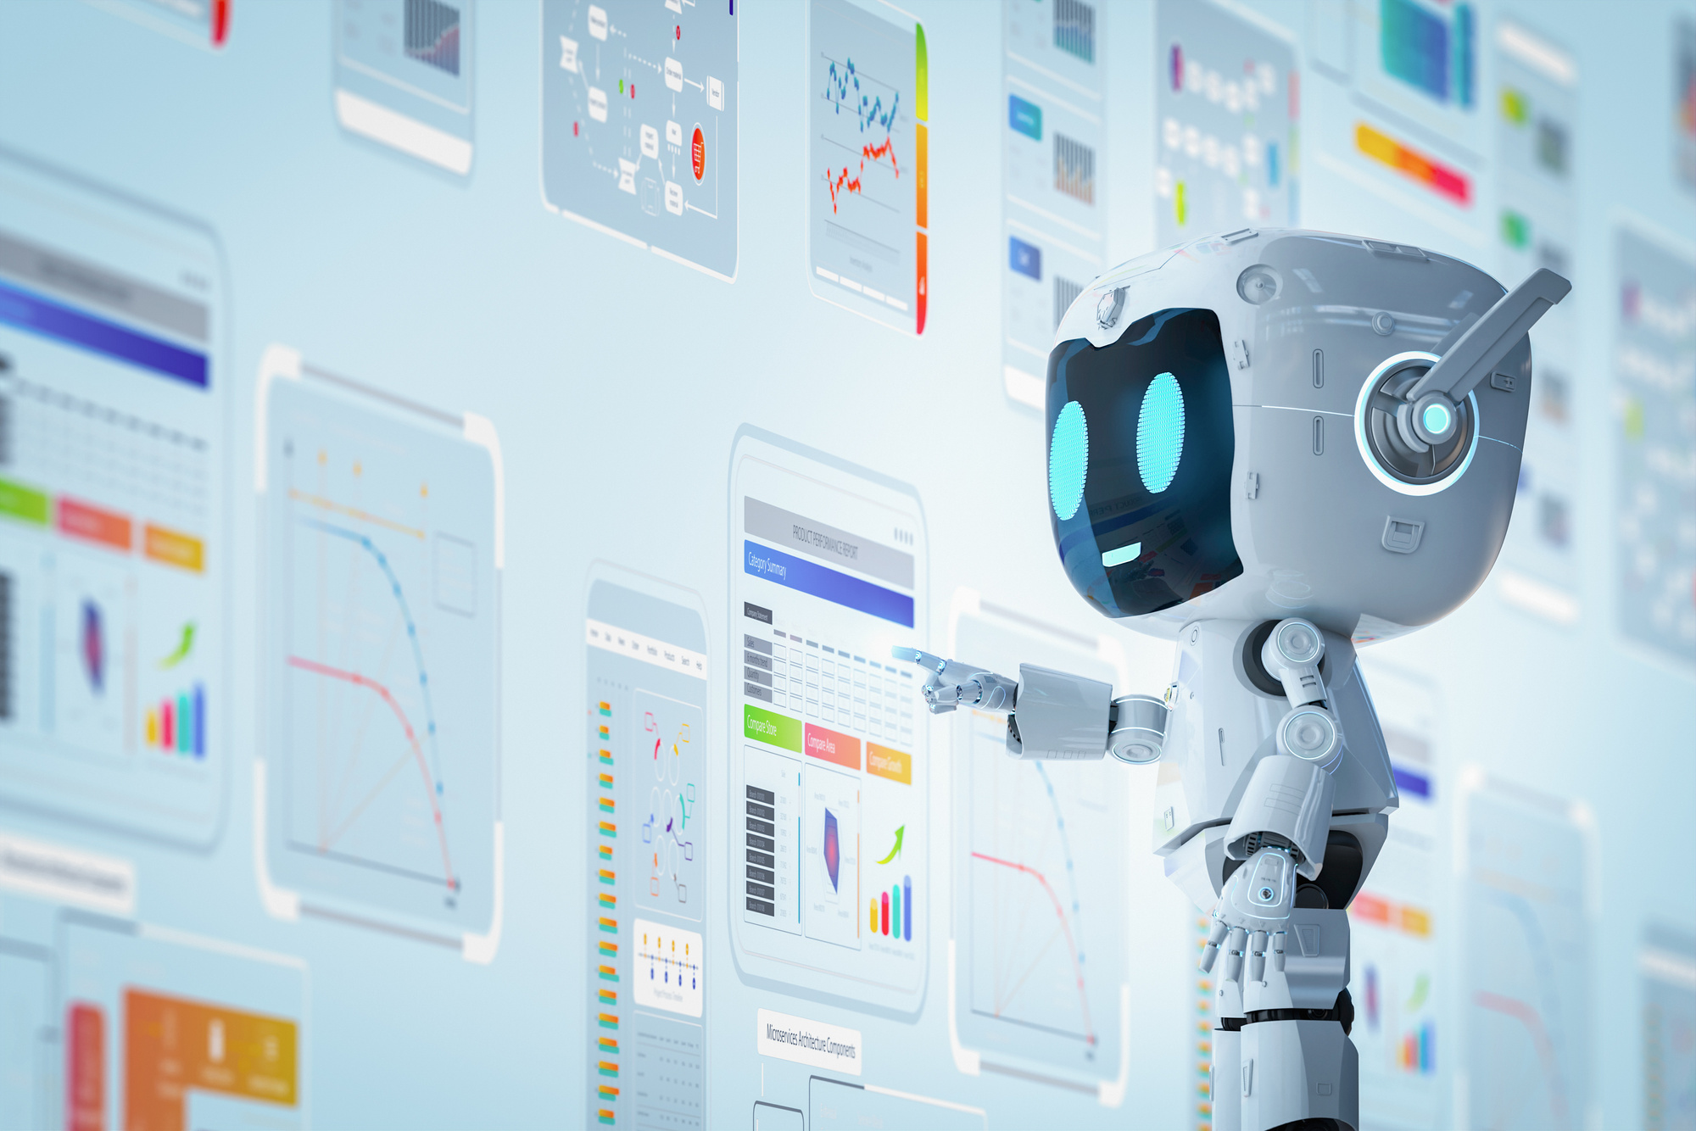
AREA OVERVIEW
AI in education is a rapidly growing field that transforms learning into a more personalized, efficient, and engaging experience.
It supports teachers and provides students with adaptive learning pathways.
IMPORTANCE OF AREA
Education is the foundation of human development, and AI is bringing a revolution in this field.

Slide 3

Potential Challenges and Opportunities
Not all students have equal access to digital devices or AI-powered tools.Advanced AI solutions can be expensive for schools and institutions.
AI can adapt lessons to individual student needs and pace.Chatbots and virtual tutors can provide 24/7 assistance.Helps track performance trends and prevent dropouts.

Slide 4
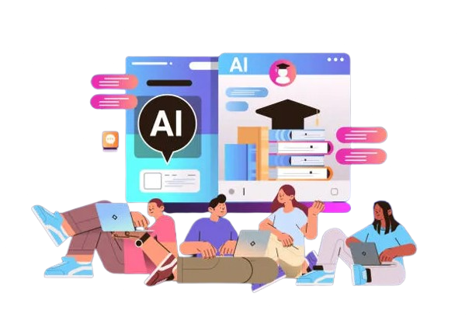
Preliminary Solution Concept
A chatbot or virtual tutor that provides personalized learning support, answers student queries instantly, and guides them with resources.
Suggests study material, practice questions, or video lectures based on a student’s performance and weak areas.

Slide 5
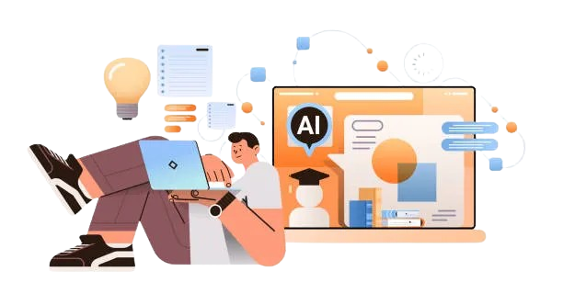
Key Features and Functionalities
Adaptive lessons based on student’s pace, style, and performance
AI chatbot/tutor to answer questions anytime.Instant grading, feedback, and progress tracking.

Slide 6
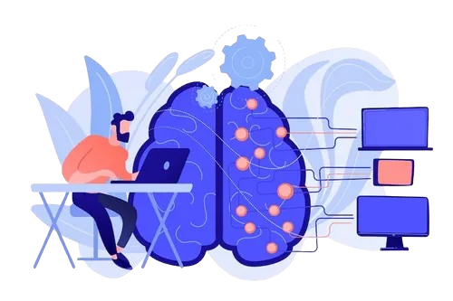
Target Users and Expected Use Cases
Get personalized learning, instant doubt solving, and performance tracking for jee students
Track child’s progress and receive AI-driven recommendations for Parents
Students interact with AI for 24/7 learning support.
Speech-to-text, translations, and adaptive content for special-needs learners.
Suggest potential use cases, showing how users might interact with the AI in typical scenarios.

Slide 7

Data Requirements and Privacy Considerations
Personal details, learning history, performance scores, and feedback.
Study material, questions, assignments, and multimedia resources.
Only authorized teachers/institutions can access data.
Inform users how their data is being used.
Highlight any data privacy or security measures to protect user information in the selected sector.

Slide 8
AI Technologies and Methods
For chatbots, virtual tutors, and language translation to interact naturally with students NLP”Natural Language Processing”
ML for analyze student performance, personalize learning paths, and recommend resources.
Speech Recognition & Text-to-Speech Helps differently-abled learners, enables voice-based learning.
Data Mining & Analysis Extracts insights from student records to improve teaching methods and outcomes.

Slide 9
Implementation Approach
Phase 1 – Requirement Analysis
Identify needs of students, teachers, and institutions; define scope.
Phase 2 – Data Collection & Preparation
Gather student records, learning content, and anonymize sensitive data.
Phase 3 – Model Development
Build AI models using NLP, ML, and predictive analytics for personalized learning and assessments.
Phase 4 – Prototype & Testing
Develop a working prototype, test with small user groups (students/teachers).
Phase 5 – DeploymentDeploy on
web platforms with secure cloud infrastructure.
Phase 6 – Feedback & Improvement
Collect feedback, monitor system performance, and improve continuously.

Slide 10
Evaluation Metrics
Learning Outcomes – Improvement in student grades, test scores, and concept clarity.
User Engagement – Active participation, time spent on platform, repeat usage.
Response Time – Speed of AI in answering queries and providing feedback.
Accuracy & Reliability – Correctness of recommendations, grading, and predictions.

